Slide 1
SHAO Low Frequency Pulsars Search Weekly Report
Tin-yau Yu

Slide 2
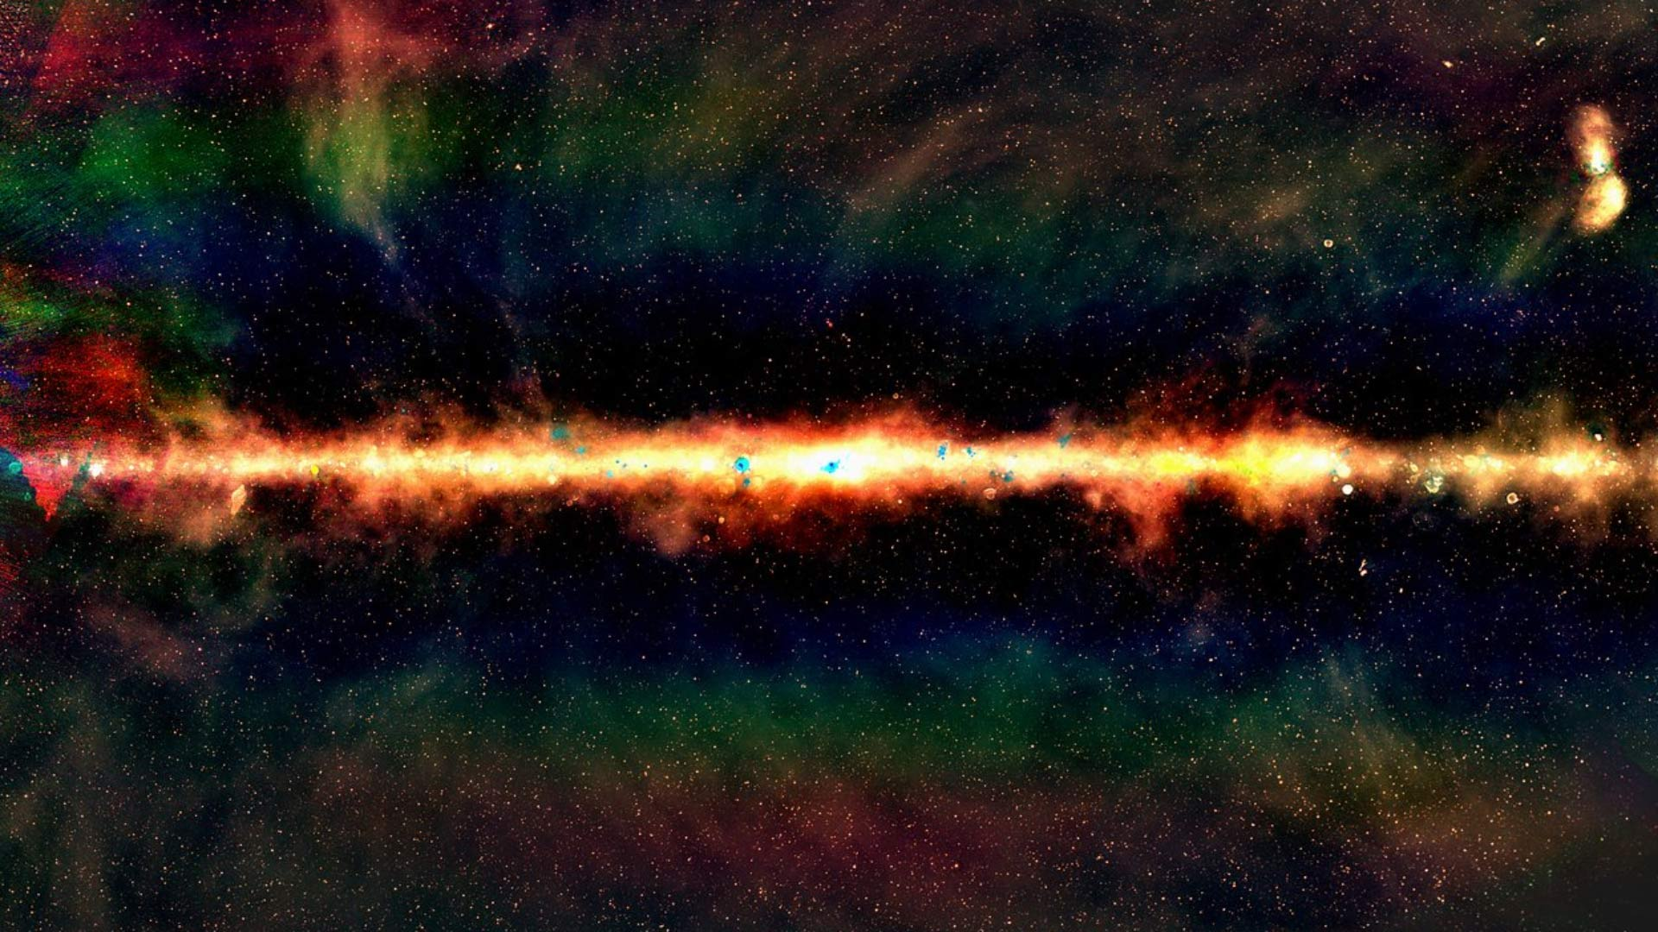


Slide 3
Introduction to Pulsars (PSR)
Extremely dense rapid rotating neutron stars.

Slide 4
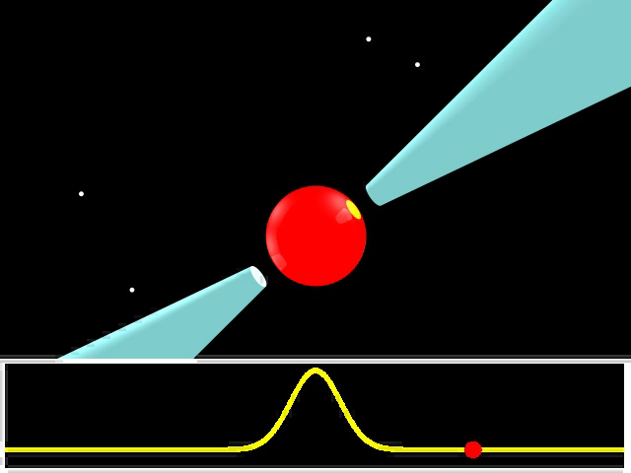
Animation

Slide 5
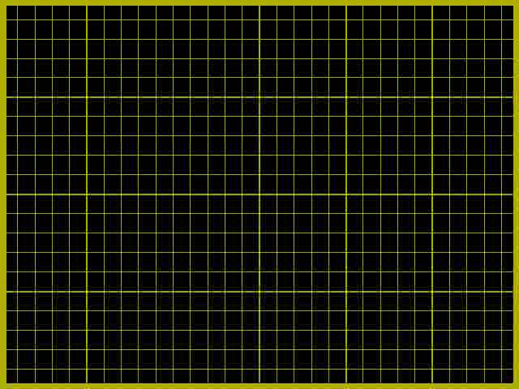
Individual pulses differ from each other in both shape and intensity due to uncertain emission mechanisms.

Slide 6
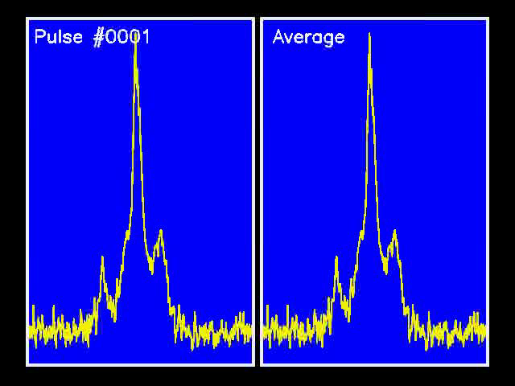
Averaging Pulses

Slide 7
Objectives
Stage 1
Re-establish the results written in Xue et al. 2017
Stage 2
Blind Search in Obs ID and compare with known PSR results
Stage 3
Evaluate method of detection
https://github.com/tinyautimothyyu/SHAO-PRSsearch 2018/blob/master/Project%20Proposal/Low_Frequency_Pulsar_Search_Project_Plan.pdf

Slide 8
Current Progress
45/50 pulsars’ profiles are re-established
Obs ID of three PSRs are missing in the cluster i.e. J1731-4744, J1751-4657, J1752-2806
J1917+1353: ERROR: MJD 57531.777 out of range. (0.00 to 0.000)
J1440-6344: Bad PSR’s profiles, reason: unknown
Learning the procedure and method of blind search
List of Obs IDs have no corresponding PSR’s results mentioned in Xue et al. 2017

Slide 9
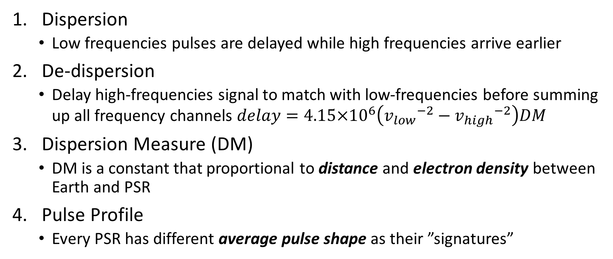
Terms Definition
Dispersion
Low frequencies pulses are delayed while high frequencies arrive earlier
De-dispersion
Delay high-frequencies signal to match with low-frequencies before summing up all frequency channels $delay=4.15×{10}^{6}\left({v_{low}}^{−2}−{v_{high}}^{−2}\right)DM$
Dispersion Measure (DM)
DM is a constant that proportional to distance and electron density between Earth and PSR
Pulse Profile
Every PSR has different average pulse shape as their ”signatures”

Slide 10
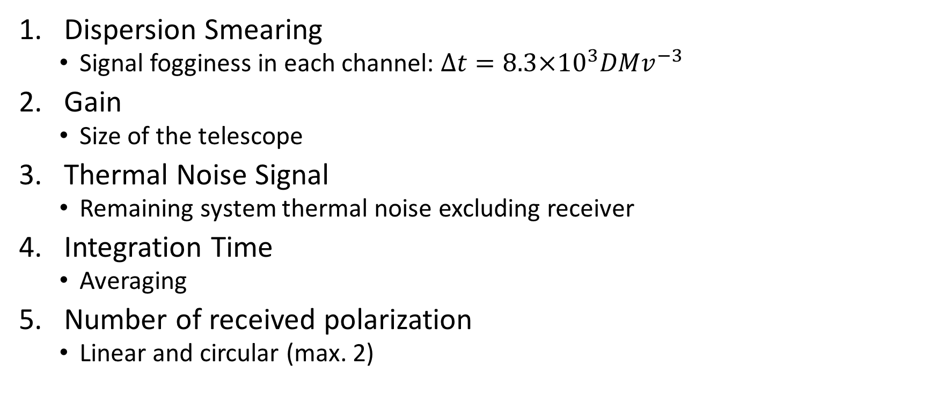
Sensitivity
Dispersion Smearing
Signal fogginess in each channel: $∆t=8.3×{10}^{3}DMv^{−3}$
Gain
Size of the telescope
Thermal Noise Signal
Remaining system thermal noise excluding receiver
Integration Time
Averaging
Number of received polarization
Linear and circular (max. 2)

Slide 11
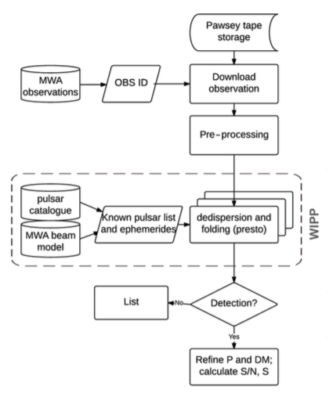
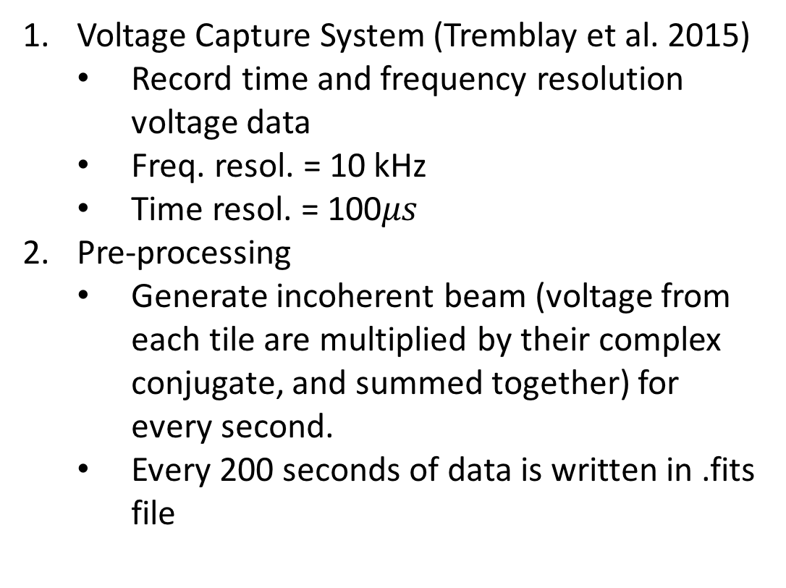
MWA-VCS Pipeline
Voltage Capture System (Tremblay et al. 2015)
Record time and frequency resolution voltage data
Freq. resol. = 10 kHz
Time resol. = 100$μs$
Pre-processing
Generate incoherent beam (voltage from each tile are multiplied by their complex conjugate, and summed together) for every second.
Every 200 seconds of data is written in .fits file

Slide 12
MWA-VCS Pipeline
Processing
Use prepfold function in PRESTO to de-disperse and fold the data to detect PSRs in the source list
Detection
PRESTO outputs are inspected by eyes (?)

Slide 13
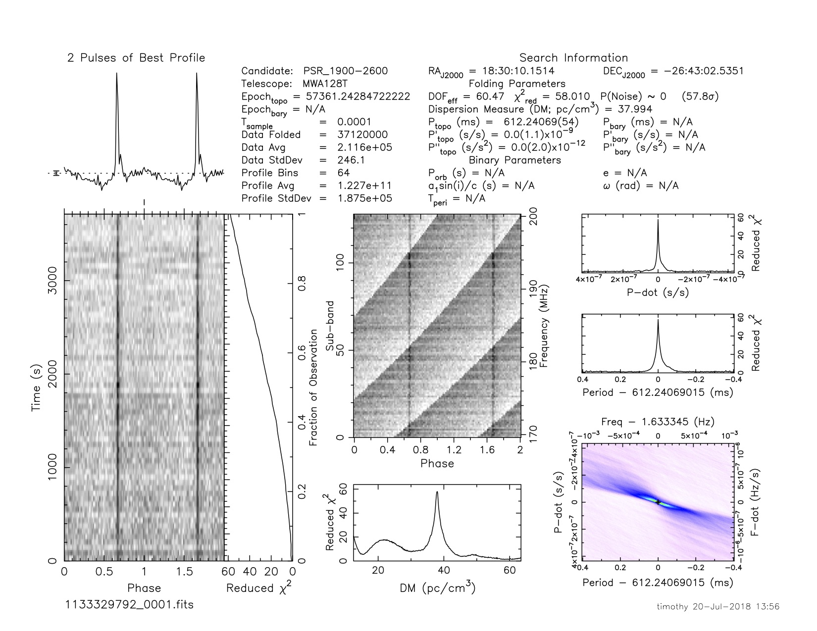
Successful Detection

Slide 14
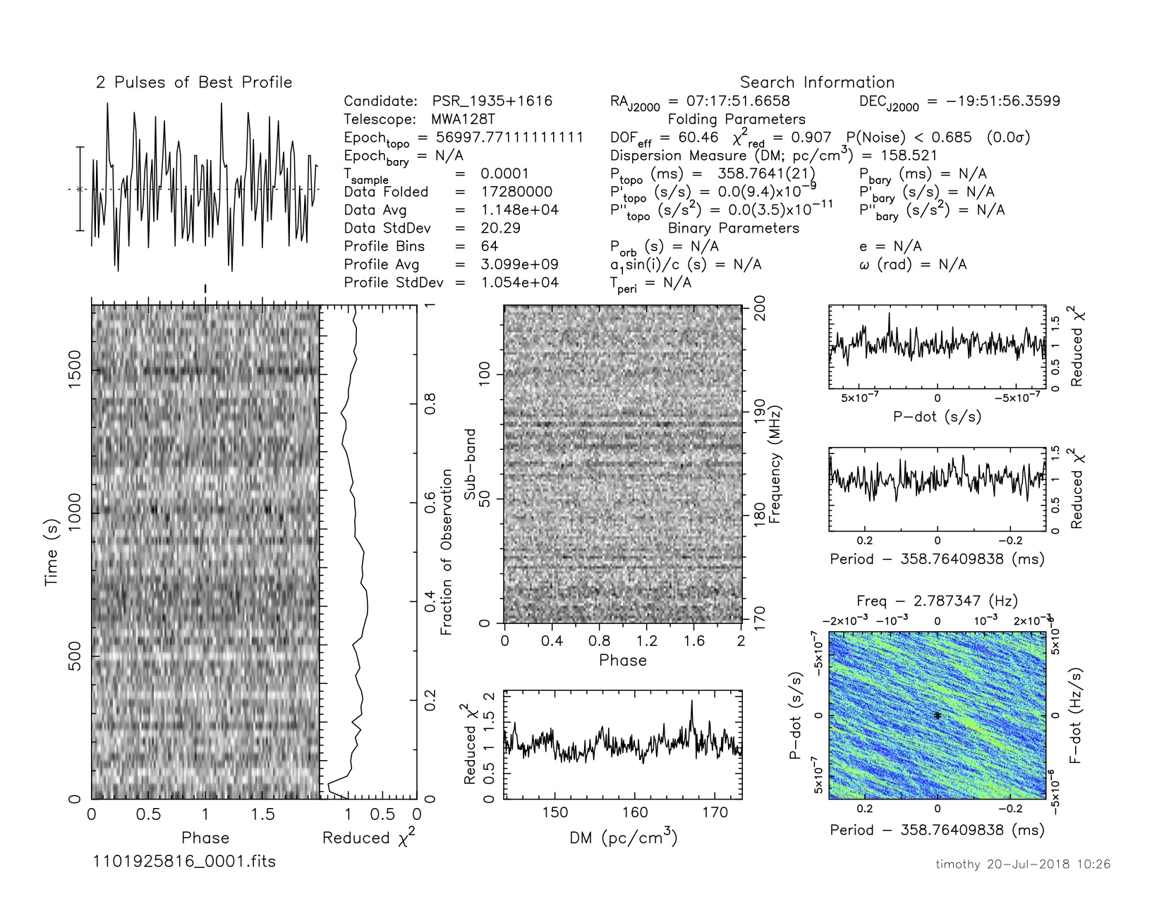
Unsuccessful Detection

Slide 15
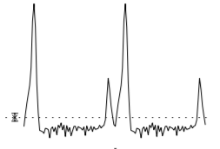
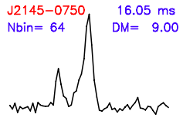
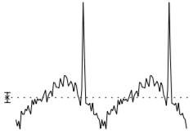
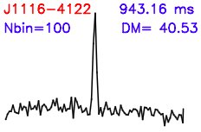
Comparing the pulse shape: 1

Slide 16
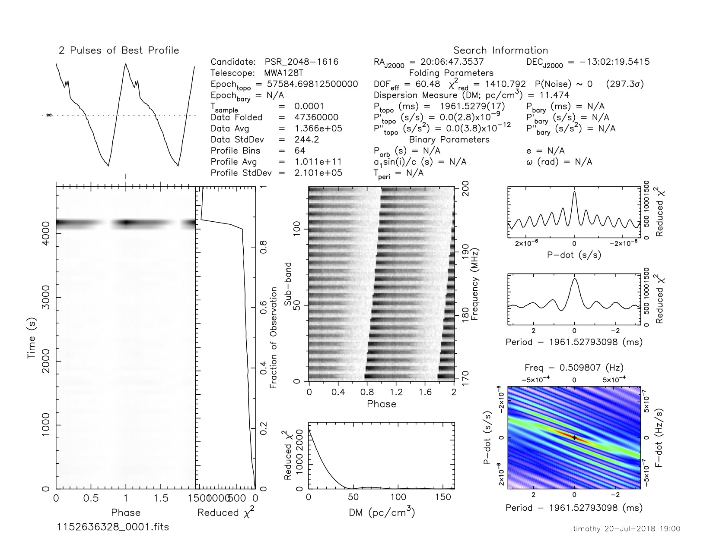
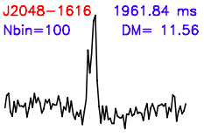
Comparing the pulse shape: 2

Slide 17
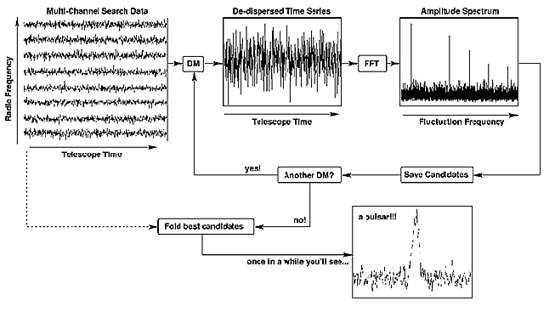
Blind Search
In the circumstances that DM and P0 are unknown, search for all PSRs in a specific area.

Slide 18
Blind Search
Data as a function of time in different channels
Given a value of DM, data is de-dispersed
Candidate frequencies of PSR are revealed in the FFT
Candidates are saved
Another value of DM is used to repeat 2-4
When full range of DM has been searched, original time series data can be folded with the candidate periods suggested from FFT analysis.
PSR?

Slide 19
Raw Data Processing
Examine the raw data
readfile filename.fits
Check for RFI
rfifind -time t_{int} -o Lband filename.fits
De-disperse
prepdata -nobary -o Lband_topo_DM0.00 -dm 0.0 -mask Lband_rfifind.mask –numout integer filename.fits
FFT (Look for RFI candidates)
explorefft Lband_topo_DM0.00.fft
Find periodic interference
Get “birdies”

Slide 20
Discussion
Better inspection method – increasing number of sources, slide 11
Simple program to do multiple prepfold in searching for all PSRs from Obs ID
Other oscillation appear in slide 14
Oscillating CHI2 in slide 15

Slide 21
Reference
Hotan A. W., van Straten W., Manchester R. N., 2004, PASA, 21, 302
Jodrell Bank Observatory, Frontier of Modern Astronomy http://www.jb.man.ac.uk/distance/frontiers/content.htm
PRESTO: https://www.cv.nrao.edu/~sransom/presto/
Ray P. S. et al., 2011
Surnis Mayuresh, Radio Pulsar Search and Timing, 2017. file:///Users/menorahlam/Downloads/Mayuresh_Thesis_Final.pdf
Xue et al., 2015, PASA

